Slide 1

Building a Smarter AI-Powered Spam Classiﬁer

Slide 2

Introduction
Welcome to the presentation on Enhancing Email Security: Developing an Intelligent AI- Powered Spam Classiﬁer. In today's digital age, email security is of utmost importance. This presentation will explore the challenges of spam emails and how an intelligent AI-powered classiﬁer can effectively mitigate this issue. Let's dive in!

Slide 3
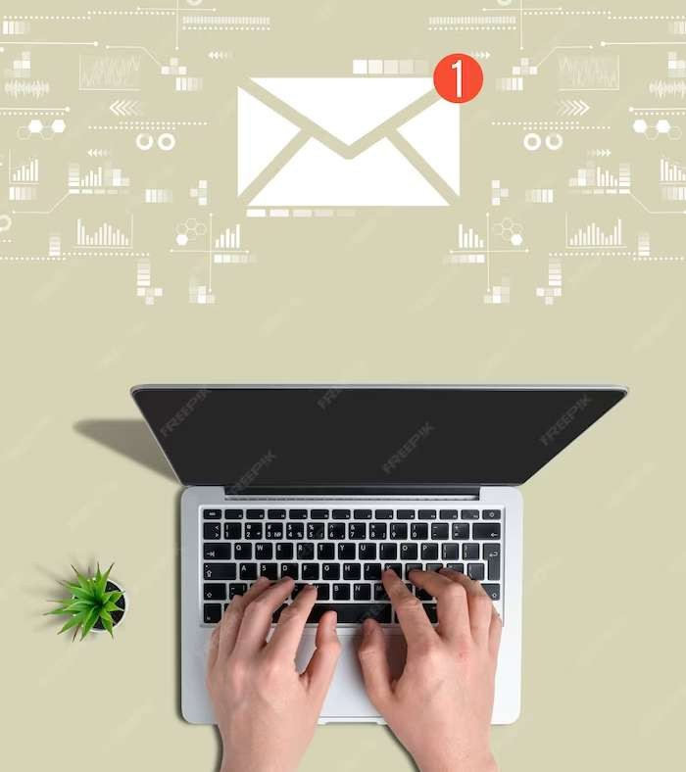
The Problem with Spam Emails
Spam emails pose a signiﬁcant threat to individuals and organizations, leading to privacy breaches, data theft, and ﬁnancial scams. Traditional spam ﬁlters are often limited in their effectiveness, resulting in an overwhelming number of unwanted emails reaching our inboxes. It's time to take a proactive approach to combat this issue using AI- powered technology.

Slide 4

AI-Powered Spam Classiﬁcation
By leveraging the power of Artiﬁcial Intelligence (AI), we can develop an advanced spam classiﬁer that intelligently identiﬁes and ﬁlters out spam emails. This AI-powered solution utilizes machine learning algorithms to analyze various email attributes, including sender information, content, and email patterns. By continuously learning from user feedback, the classiﬁer becomes more accurate over time.

Slide 5

Beneﬁts and Future Implications
Implementing an intelligent AI- powered spam classiﬁer offers numerous beneﬁts, including enhanced email security, reduced risk of phishing attacks, improved productivity, and better user experience. Furthermore, this technology can be extended to other areas, such as fraud detection, content ﬁltering, and email prioritization. Let's embrace this innovation to safeguard our digital communication.

Slide 6
Conclusion
In conclusion, developing an intelligent AI-powered spam classiﬁer is a crucial step in enhancing email security. By leveraging AI and machine learning, we can effectively identify and ﬁlter out spam emails, reducing the risks associated with malicious content. Let's embrace this technology and ensure a safer and more secure email environment for all.

